Slide 1
Introduction To Python (Python Overview)
Platform Lead Limited
Omotoso Abdul-Rauf

Slide 2
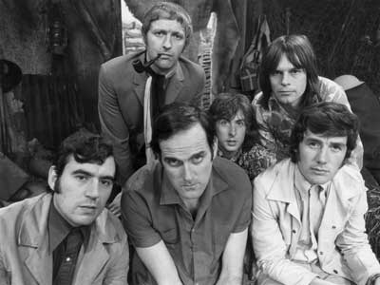
Python
Created in 1991 by Guido van Rossum
Named for Monty Python
Useful as a scripting language
script: A small program meant for one-time use
Targeted towards small to medium sized projects
Used by:
Google, Yahoo!, Youtube
Many Linux distributions
Games and apps (e.g. Eve Online)

Slide 3
Uses
It is used for:
web development (server-side),
software development,
Mathematics
Data Analysis/Data Science
System Scripting
ML/AI
Ethical Hacking

Slide 4
Versions
We have two different versions of python:
Python 2
Python 3
But for this training we will be using python 3.x
Python works on different platform ( Windows, Mac, Linux, Raspberry Pi, android, iOS)

Slide 5
Installing Python
Windows:
Download Python from http://www.python.org
Install Python.
Run Idle from the Start Menu.
Mac OS X:
Python is already installed.
Open a terminal and run python or run Idle from Finder.
Linux:
Chances are you already have Python installed. To check, run python from the terminal.
If not, install from your distribution's package system.
Note: For step by step installation instructions, meet your instructor.

Slide 6
Interpreted Languages
interpreted
Not compiled like Java
Code is written and then directly executed by an interpreter
Type commands into interpreter and see immediate results
Java:
Code
Compiler
Runtime
Environment
Computer
Python:
Code
Interpreter
Computer

Slide 7
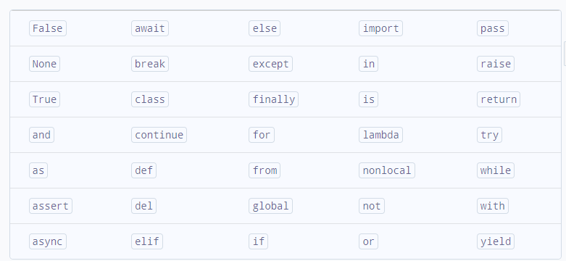
Keywords
There are 33 keywords in Python 3.x. This number can vary slightly over the course of time.
In python keywords are case sensitive, all keyword except True, False and None must be in lowercase. The list of all the keywords is given below.

Slide 8
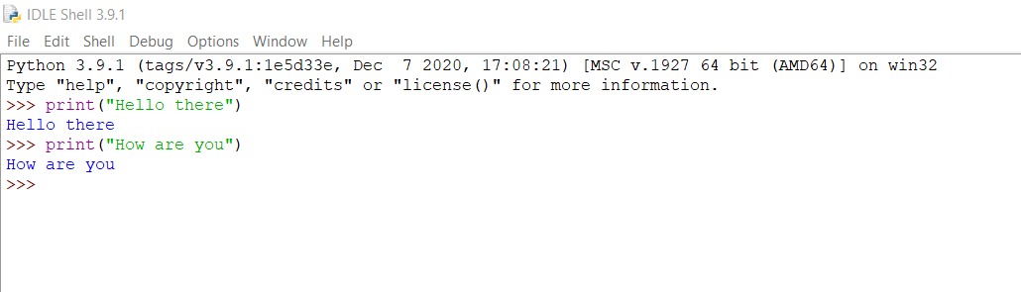
The Python Interpreter
Allows you to type commands one-at-a-time and see results
A great way to explore Python's syntax
Repeat previous command: Alt+P

Slide 9
Our First Python Program
Python does not have a main method like Java
The program's main code is just written directly in the file
Python statements do not end with semicolons
hello.py
1 | print("Hello World!")

Slide 10
The print Statement
print("text")
print() (a blank line)
Escape sequences such as \" are the same as in Java
Strings can also start/end with '
example.py
1 2 3 4 | print("Hello, world!") print() print("Suppose two swallows \"carry\" it together.") print('African or "European" swallows?')

Slide 11
Comments
#comment text (one line)
# multi-line comment
example2.py
1 2 3 4 5 6 | # Suzy Student, CSE 142, Fall 2097 # This program prints important messages. print("Hello, world!") print() # blank line print("Suppose two swallows \"carry\" it together.") print('African or "European" swallows?')
example3.py
1 2 3 4 | “”” Suzy Student, CSE 142, Fall 2097 This program prints important messages. Clandestine section “”” print("Hello, world!")

Slide 12
Functions
Function: Equivalent to a static method in Java.
Syntax:
def name():
statement
statement
...
statement
Must be declared above the 'main' code
Statements inside the function must be indented
hello2.py
1 2 3 4 5 6 7 | # Prints a helpful message. def hello(): print("Hello, world!") # main (calls hello twice) hello() hello()

Slide 13
Whitespace Significance
Python uses indentation to indicate blocks, instead of {}
Makes the code simpler and more readable
In Java, indenting is optional. In Python, you must indent.
hello3.py
1 2 3 4 5 6 7 8 | # Prints a helpful message. def hello(): print("Hello, world!") print("How are you?") # main (calls hello twice) hello() hello()

Slide 14
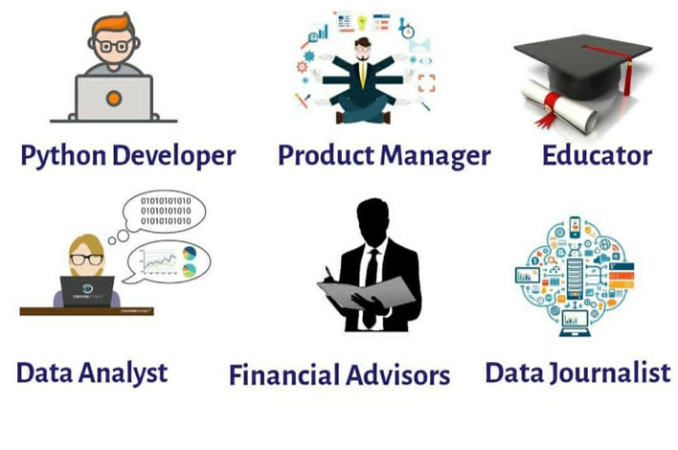
Jobs You can Land with Python Skills :
Source and reference link: https://pllpyjob.tiiny.site/

